Slide 1
Bereavement and Loss for people supporting Children
Deborah Boys
Learning and Development
West Sussex County Council

Slide 2
Welcome
House keeping
Confidentiality
Mobile Phones
Health and Safety

Slide 3
Aims
The aim of this course is to help inform your practice when working with children and young people who have experienced a bereavement and loss.

Slide 4
A Grief Observed by C.S. Lewis
“There is something new to be chronicled every day. Grief is like a long valley, a winding valley where any bend may reveal a totally new landscape. As I’ve already noted, not every bend does. Sometimes the surprise is the opposite one; you are presented with exactly the same sort of country you thought you had left behind miles ago. That is when you wonder whether the valley isn’t a circular trench. But it isn’t. There are partial recurrences, but the sequence doesn’t repeat”
(Lewis, 1961:47)

Slide 5
Learning & Development Outcomes
By the end of this course you will be able to:
Discuss bereavement and loss and what these terms mean
Describe the grieving process and how it impacts on children and young people
Identify the impact of grief and loss on children and young people
Demonstrate an understanding of the child’s journey through grief and how their chronological age affects the process
Initiate strategies for supporting children, young people and their families when experiencing loss

Slide 6
Terminology
Bereavement
Refers to the state of having lost someone, or indeed something, significant
Grief
Usually means the emotional experience that accompanies a significant loss
Mourning
Applies to the activities associated with bereavement
Loss applies to the feelings associated with all of the above which may be significant or less so…

Slide 7
Bereavement and Loss
Significant Loss?
Describe the different types of loss that you have experienced
Identify which types of loss were significant to you and why

Slide 8
Bereavement and Loss in Children
What are the different types of loss that a child might experience?
A pet
As a result of divorce or separation
A parent
Friend(s)
Grand
parent
School
Loss of…
Sibling
Transition/
milestones
Home

Slide 9
The grief process
Bereavement can occur when there is a significant loss to that person
The significance of the loss is individual to each person
The ways in which people deal with their feelings surrounding loss will also be different

Slide 10
Break

Slide 11
Factors that can influence bereavement and loss
The timing of the loss
The occurrence of several losses or of loss with other major lifecycle changes
A history of traumatic loss and unresolved mourning
The nature of the death
The significance and function of the person

Slide 12
Relationships
Problematic relationships in childhood are particularly damaging.
Mistrust, shame and guilt are linked to young people who have experienced unsupported separation from parents, inconsistent parenting, physical violence, sexual abuse

Slide 13
Fahlberg talks about the fact that the consequences of multiple moves in foster care means that children are ‘particularly’ vulnerable to severe problems in the development of social emotions, carrying with it long-term implications for interpersonal relationships, conscience development and self esteem (1994; 138)

Slide 14
Current theories of grief and bereavement
The notion that a satisfactory outcome
in loss or bereavement depends upon
emotional expression of grief
Sigmund Freud

Slide 15
Worden (2003)
The process of adjustment to loss
commonly known as ‘grief work’ using
grief counselling and grief therapy
(Worden, 2003)

Slide 16
The four tasks of grieving
To accept the reality of the loss
To work through the pain of grief
To adjust to the environment without the deceased
To emotionally relocate the deceased and move on with life
Worden, 1991

Slide 17
Theories of counselling intervention through creation of a safe base in which to explore feelings and concerns.
Attachment theory which promotes security (Holmes, 1993); Person centred approach (Rogers, 1961, 1980), (Ainsworth, 1978)

Slide 18
Attachment Theory
Anxious/
Ambivalent attachment
Secure attachment
Avoidant attachment
Overwhelmed loss response and anxious
Balanced/resilient loss response
Controlled loss response
Notes:
Links between attachment theory and Range of Response to Loss (RLL) model
Machin, L. (1980) Working with Loss & Grief, Sage Publications

Slide 19
Grief theories cont.
The characteristics of grief, particularly as they relate to bereavement are founded in the work of Bowlby (1980); Kubler Ross (1970) and Parkes (1996) collectively known as stage and phase models of grief

Slide 20
Stage and phase models
Denial
Despair
Guilt
Anger
Hopelessness
Bargaining
Acceptance
Mourning

Slide 21
Sugarman (2001)
Dealing with death and bereavement often obscures the reality that multiple losses are experienced across the life cycle e.g. those that come with developmental change
Some of these ‘little losses’ are rehearsals for more profound encounters with loss and provide a strengthening of emotional and cognitive capacities

Slide 22
Sugarman (2001) cont./…
Coping demands are fully tested when relationships or health are damaged or disintegrate and where deeply held aspirations are thwarted or unexpected or traumatic death occurs

Slide 23
Stroebe and Schut (1999)
Grief as a two dimensional process:
Loss orientation – dealing with the distress of grief
Restoration orientation – focus on diversion from grief and attention to ongoing life demands
Successful movement between these two grief modes is necessary to adapt to loss

Slide 24
Lazarus and Folkman (1984)
Where internal resources and external sources of support are inadequate for the meeting of loss, vulnerability will result
Recognising loss and the vulnerability it may produce is central to the process of helping a person overcome bereavement and loss

Slide 25
Children and Young People’s experience
Make links to the children you are supporting

Slide 26
http://
http://www.youtube.com/watch?v=Oln5A5ZrSQg
Winston’s Wish

Slide 27
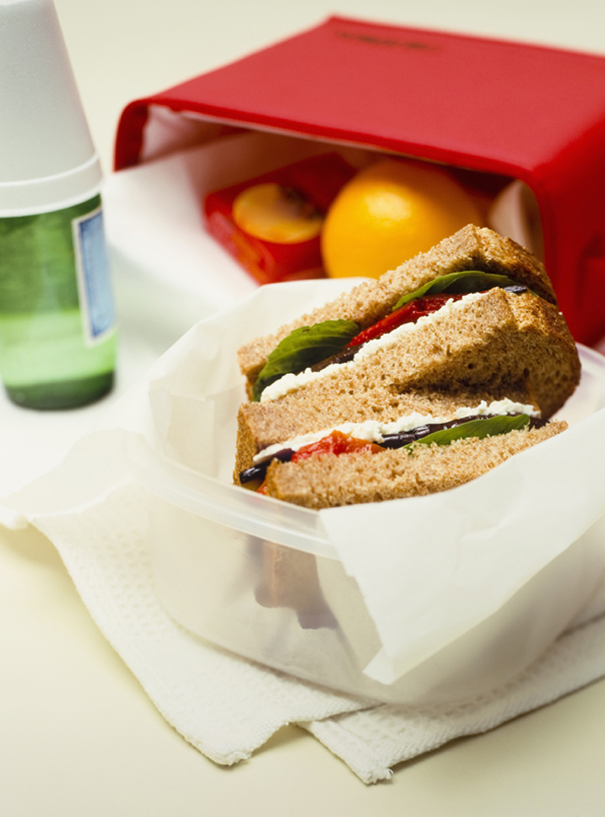
Lunch

Slide 28
Children and their grief experience
Factors to consider
The age of the child
Their experience of loss
The child’s coping strategies
The presence and support of family, friends, carers
The child’s mental health and well-being
The child’s understanding about what has occurred

Slide 29
The experience of bereavement
Bereavement causes a great intensity and variety of emotions which may be felt for many months, if not years, after the death or loss of connection with someone close.
In children sometimes these feelings do not manifest until later adulthood.

Slide 30
Developmental Grief is…
A grief that returns through memories of that loss.
Grief may return during the holidays or on the anniversary of the loss. Adult adoptees may experience developmental grieving at their own weddings, birth of a child, or graduation; situations that recall the loss of their own birth families.
Children in a foster care situation may experience the same feelings during typical family times, like birthdays or holidays.

Slide 31
http://www.youtube.com/watch?v=Qwj2JTCY7Rk
Germaine’s Story
Winston’s wish

Slide 32
Supporting Children
What we do can make the experience of bereavement and loss easier to cope with…
Provide a safe and secure base in which the child feels able to be supported and listened to
Create opportunities for the child to express how they are feeling
Work with the child at their pace and time

Slide 33
Divorce and Separation
Hints and Tips
If possible and appropriate, assist the child to maintain contact with both parents or main care giver
Encourage the child to talk about their feelings when they wish to
Help the young person to understand that the separation was not their fault
Encourage participation in social activities to help channel any negative energies surrounding separation but recognise that this might be difficult
Help the child to settle into new routines and establish feelings of security
Build on strengths and sense of self worth and identity as individuals

Slide 34
Communication
Contact a professional if you feel the sadness is sticking around too long.
Some warning signs to watch for include:
The child loses interest in daily activities and interests
Inability to sleep and loss of appetite.
Acting much younger than chronological age for an extended period of time
Sharp drop in school performance
‘Acting out’ being out of character for them i.e. exaggerated behaviour

Slide 35
Break

Slide 36
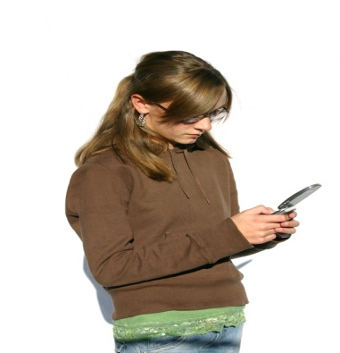
Activity to promote well being…
Treasuring Memories
Making a memory box or a memory book can help children to talk about the person who has died. This also gives children the opportunity to continue to have a relationship with that person

Slide 37
Memory Box
If you were supporting a child or young person to make a memory box what are the items that could be put in to it?

Slide 38
Remembering
It is important that people are able to talk about and remember someone after they have died. For children, opportunities to remember can assist in maintaining a special relationship with that person, which is likely to have a positive impact on their future emotional development

Slide 39
Activities to promote remembering…
Write a letter, Make a card
Take some flowers or a card to the grave
Make a scrapbook
Plant a tree or shrub, bulbs, flowers
Make a CD of favourite tunes
Visit places that make you feel happy
Keep a journal
Talk about the person you are missing with someone who knows them or who is willing to listen

Slide 40
Divorce and separation
http://www.sesamestreet.org/parents/topicsandactivities/toolkits/
divorce and Separation
http://www.youngminds.org.uk/for_parents/worried_about_your_child/divorce_separation?gclid=COnAxOOXpLQCFYXLtAodrVUAIQ
Feeling Angry
http://www.youngminds.org.uk/assets/0000/0720/Feeling_Angry_.pdf
Explaining divorce to young children

Slide 41
Anger (podcast)
http://www.youngminds.org.uk/assets/0000/0427/070903_YM_Anger.mp3

Slide 42
Bereavement and Loss
Cancer and Leukaemia in Childhood (CLIC) www.clic.org.uk
The Child Bereavement Trust
www.childbreavement.org.uk
Sargent Cancer Care for Children
www.sargent.org
Winston’s Wish (for bereaved children) www.winstonswish.org.uk
Little children, big challenges: Divorce
http://www.sesamestreet.org/parents/
topicsandactivities/toolkits/divorce

Slide 43
Bereavement /War/Disaster
The Bereavement Manual
http://www.childrenandwar.org/resources/grief-manual/
Uses information and research gathered from children bereaved due to war, natural disasters and trauma. Designed as a multi-cultural resource based on Teaching Recovery Techniques (TRT) which helps the child develop coping strategies to reduce effects of bereavement and loss.

Slide 44
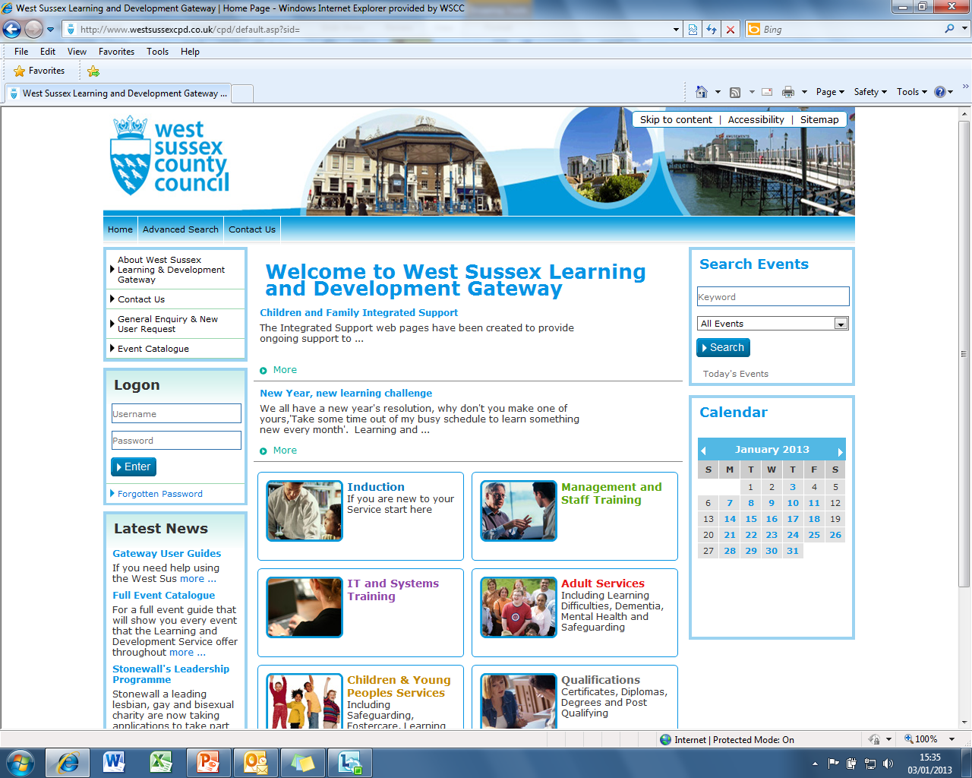
Learning Gateway

